Slide 1

BeagleBone

Slide 2
BeagleBone- Open Source
BeagleBone– helps hobbyists, engineers and students alike transform ideas into usable products.
BeagleBone Black is a ready-to-use, 1-GHz Linux™ computer that offers a truly open hardware and software development platform.
BEAGLE
Bring your own peripherals
Entry level cost ($149/179)
ARM Cortex-A8 (Superscalar)
Graphics and DSP accelerated
Linux and open source community
Environment for innovators
Produced by Texas Instruments

Slide 3
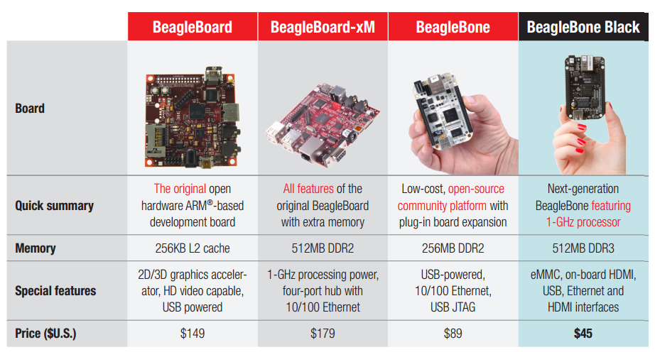
BeagleBone Generations

Slide 4
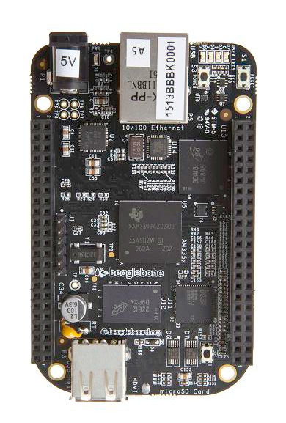
BeagleBone Black- Hardware
Processor AM335X 1GHz ARM cortex A8
512 MB DDR3 RAM
4 GB 8 bit eMMC on-board flash storage
Connectivity
USB client for power and communication
USB host
Software compatibility
Debian
Ethernet
HDMI
2x46 pin headers
Angstrom
Android
3D graphics accelerator
Cloud9 IDE

Slide 5
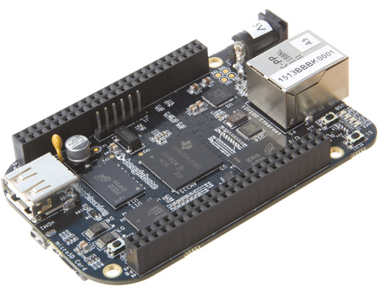
BeagleBone Black
10/100 Ethernet
Power Button
DC Power
LEDS
USB Host
Serial Debug
Reset Button
Easily connects to almost any everyday device such as mouse or keyboard
USB Client
Development interface and directly powers board from PC
microHDMI
2GB on-board storage using eMMC
Pre-loaded with Ångström Linux Distribution
8-bit bus accelerates performance
Frees the microSD slot to be used for additional storage for a less expensive solution than SD cards
Connect directly to monitors and TVs
1 GHz Sitara AM335x ARM® Cortex™-A8 processor
Expansion headers
microSD
Expansion slot for additional storage
Enable cape hardware and include:
65 digital I/O
7 analog
4 serial
2 SPI
2 I2C
8 PWMs
4 timers
And much much more!
Provides a more advanced user interface and up to 150% better performance than ARM11
512MB DDR3
Faster, lower power RAM for enhanced user-friendly experience
Boot Button
Notes:
Emphasize Sitara: It no longer appears later in this deck.
Expansion heads information will enable you to transition to capes slide.

Slide 6
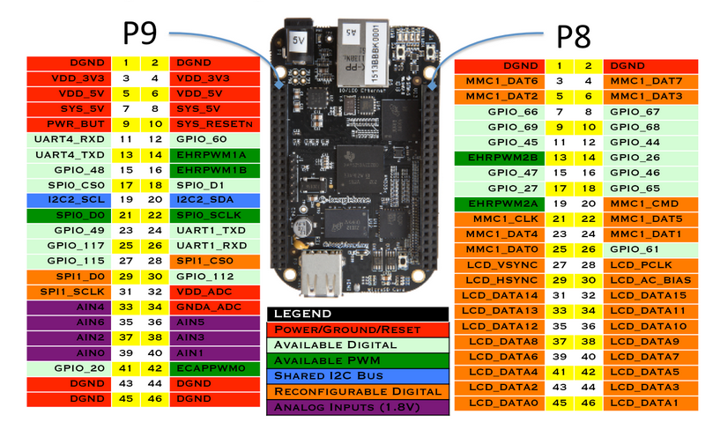
Pinout of BeagleBone

Slide 7
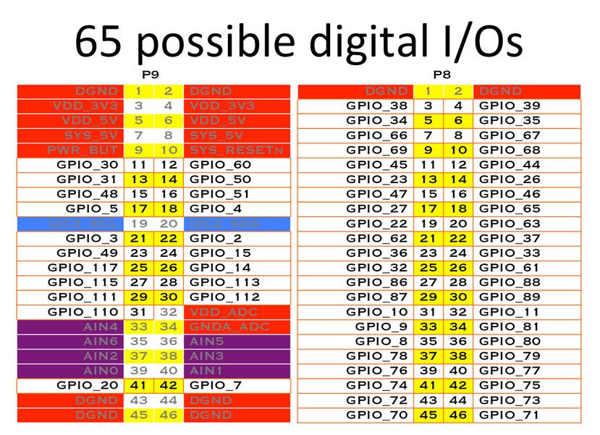
Each digital I/O pin has 8 different modes that can be selected, including GPIO
In GPIO mode, each digital I/O can produce interrupts

Slide 8
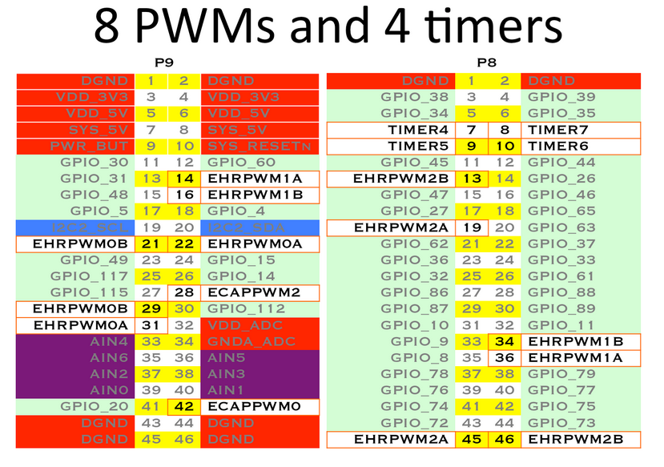
Up to 8 digital I/O pins can be configured with pulse-width modulators (PWM) to produce signals to control motors or create analog voltage levels, without taking up any extra CPU cycles.

Slide 9
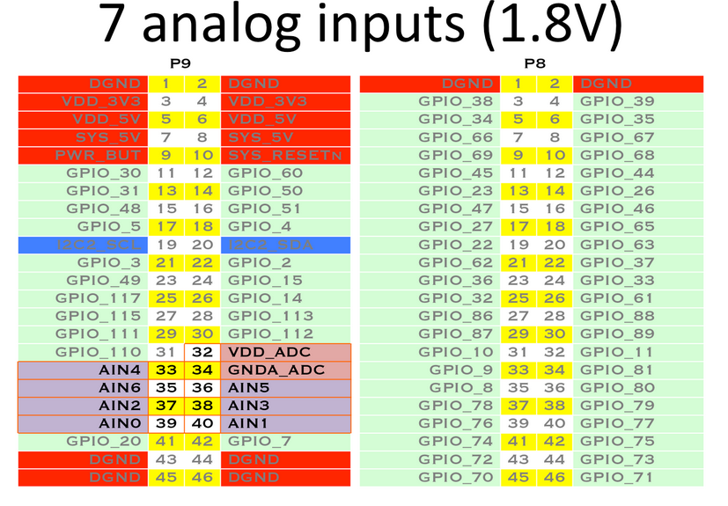
This is a single 12-bit analog-to-digital converter with 8 channels, 7 of which are made available on the headers.
Translate analog voltage value into different digital levels
Analog Sensor output is connected to analog input pins.

Slide 10
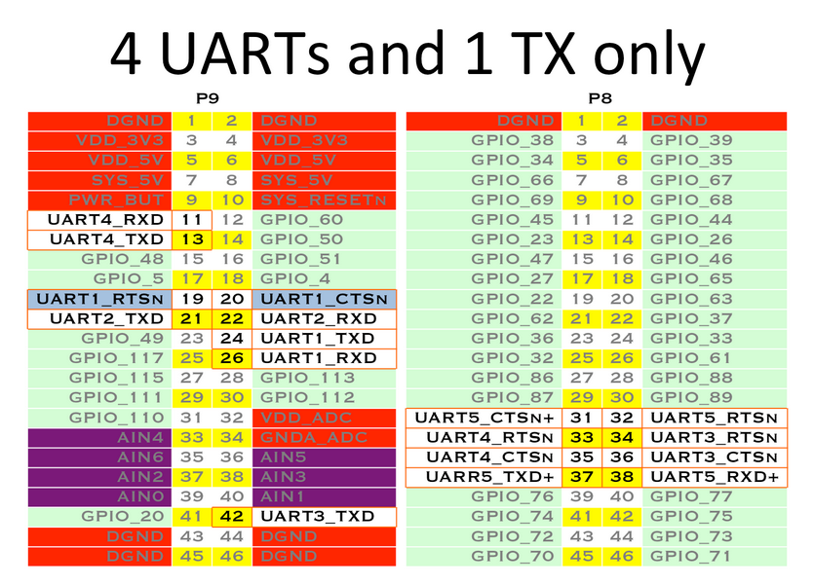
Universal asynchronous receiver/transmitter is a computer hardware device that translates data between parallel and serial forms.
There is a dedicated header for getting to the UART0 pins and connecting a debug cable. Five additional serial ports are brought to the expansion headers, but one of them only has a single direction brought to the headers.

Slide 11
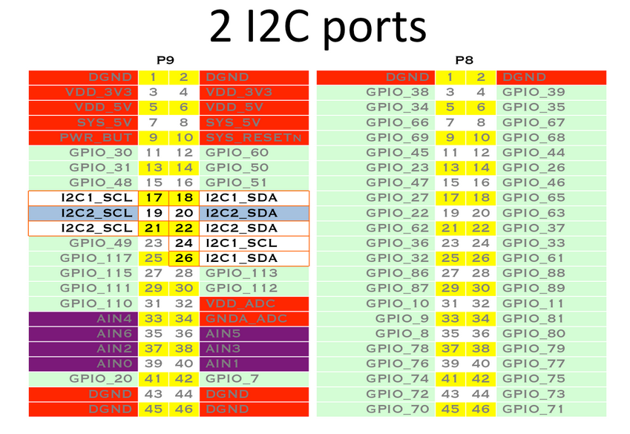
I²C (Inter-Integrated Circuit) is typically used for attaching lower-speed peripheral ICs to processors and microcontrollers
The first I2C bus is utilized for reading EEPROMS on cape add-on boards and can't be used for other digital I/O operations without interfering with that function, but you can still use it to add other I2C devices at available addresses. The second I2C bus is available for you to configure and use.

Slide 12
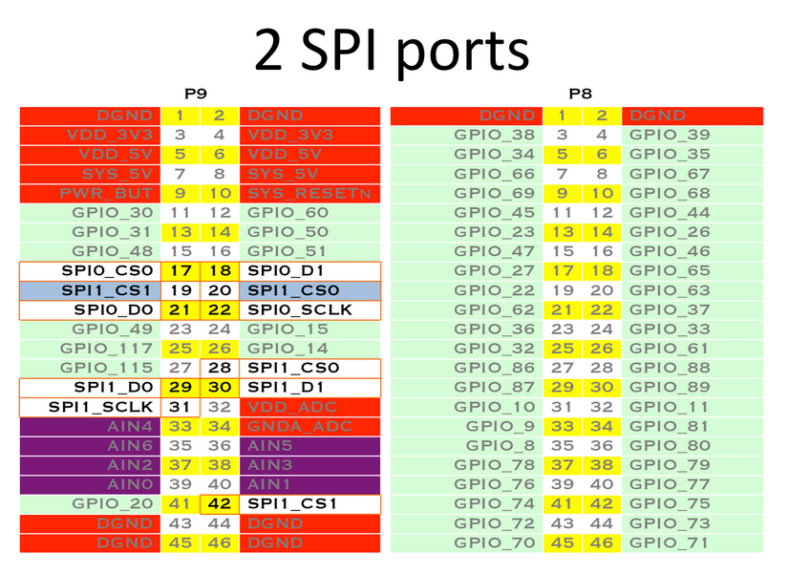
The Serial Peripheral Interface (SPI) bus is a synchronous serial communication interface specification used for short distance communication
For shifting out data fast, you might consider using one of the SPI ports.

Slide 13
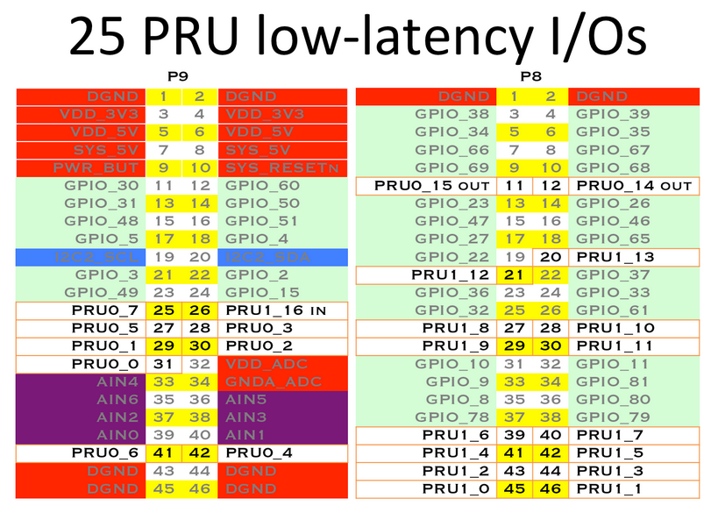
Advanced users can also make use of 2 built-in 32-bit 200-MHz microcontrollers called Programmable Real-time Units (PRUs) for performing real-time tasks. Each PRU has some pins associated with it tied directly to registers for super-low-latency access

Slide 14
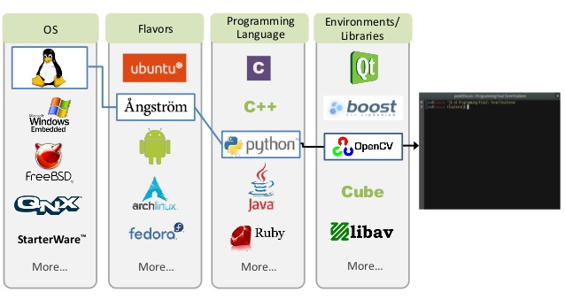
Endless Software Opportunities

Slide 15
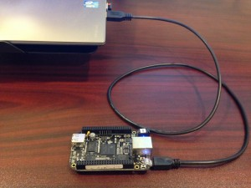
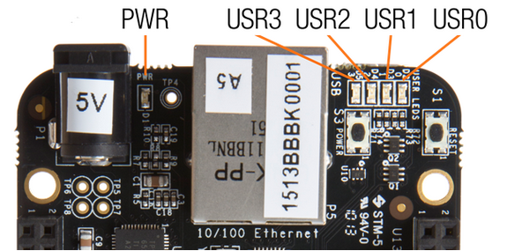
Getting Started
Plug in your BeagleBone via USB
You'll see the PWR LED lit steadily. Within 10 seconds, you should see the other LEDs blinking in their default configurations.
USR0 is configured at boot to blink in a heartbeat pattern
USR1 is configured at boot to light during microSD card accesses
USR2 is configured at boot to light during CPU activity
USR3 is configured at boot to light during eMMC accesses

Slide 16
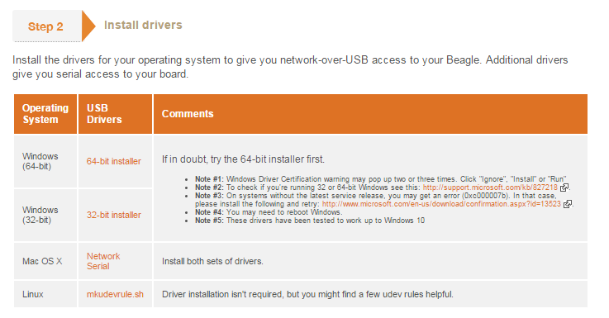
Installing Drivers
Drivers can be installed from http://beagleboard.org/getting-started

Slide 17
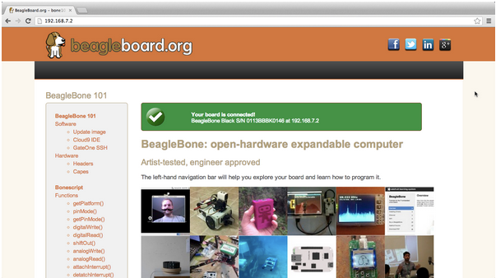
Browsing to BeagleBone
First just check that the connection is active by trying to connect to a browser
Connect to the URL http://192.168.7.2
You will see a helpful introductory web page served by BeagleBoard itself.

Slide 18
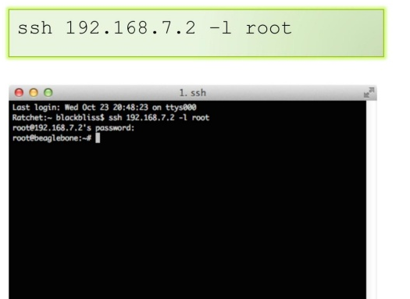
Go with SSH
If you are using Linux or Mac, simply open terminal and type the following

Slide 19

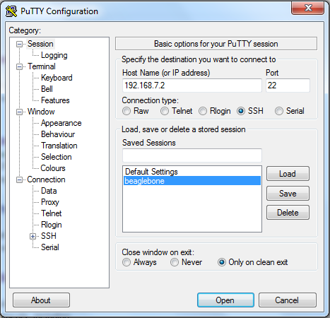
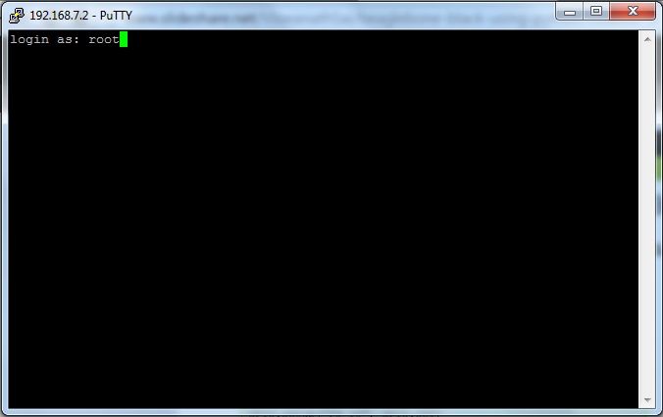
SSH for windows- PuTTY
PuTTY is a free and open source terminal emulator and network file transfer application which enable several network protocals such as SSH.
You can download PuTTY at www.putty.org

Slide 20

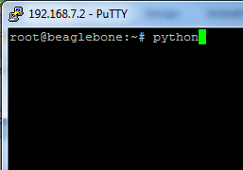
Using python

Slide 21
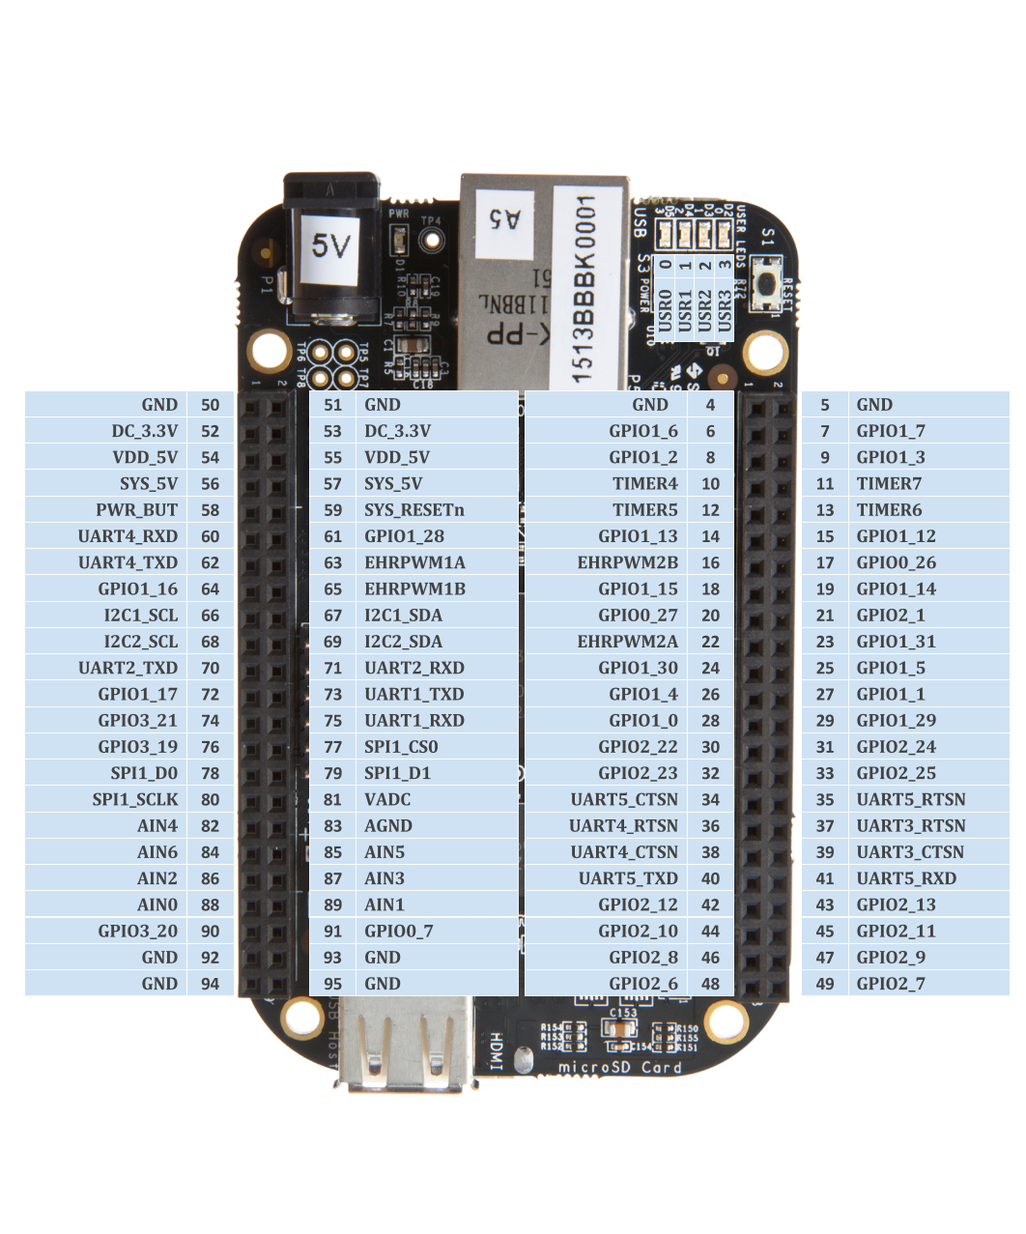
Using GPIO with Python
Available functionality:
7 Analog pins
65 Digital pins at 3.3V
2xI2C
2xSPI
2x CAN Bus
4 Timers
4x UART
8x PWM
A/D Converter

Slide 22
Using GPIO with Python(Cont.)
Import the library using the command below
import Adafruit_BBIO.GPIO as GPIO
You can access the channels by either referencing the pin “key” or the name.
import Adafruit_BBIO.GPIO as GPIO
GPIO.setup(“P8_10”, GPIO.OUT)
GPIO.output(“P8_10”, GPIO.HIGH)
GPIO.setup(“P8_14”, GPIO.IN)
if GPIO.input(“P8_14”) : print(“HIGH”)
else :
print(“LOW”)

